Slide 1
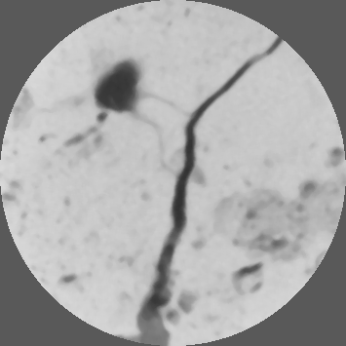

ImageJ Exercise
ImageJ available for free download:
  Open source, supported by NIH
  Works on all platforms
  We will use a “flavor” of ImageJ called Fiji:
    http://fiji.sc/wiki/index.php/Fiji
  I will use “ImageJ” and “Fiji” interchangeably
  Please download and install
Open ImageJ/Fiji from the list of programs on your laptop
Let’s perform some basic maintenance:
  Run updater: Help->Update ImageJ (or Help->Update Fiji)
  Check how much memory is available to ImageJ on your computer:
  Edit->Options->Memory & Threads
  (the default installation sets 256MB and that is too little for volumetric images -> you can set this based on memory/RAM available on your computer)
Example: fractured carbonate scan (obtained from adapted medical scanner at PGE, UT Austin (mm resolution)
Image courtesy of G. Pope/CPGE

Slide 2
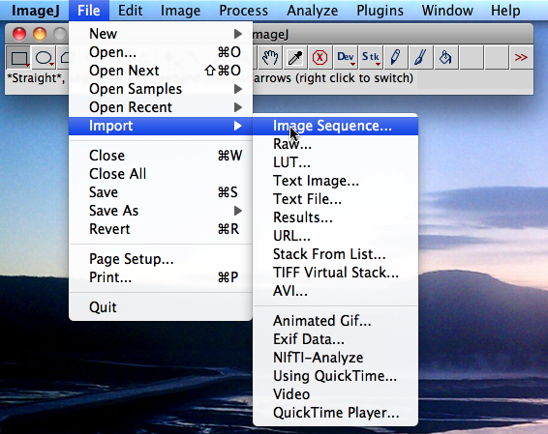
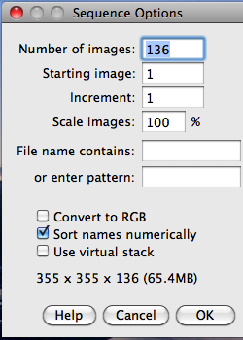
Importing an image sequence
Open ImageJ
Select File->Import->Image Sequence (see figure)
Data is in Data_FracturedCarbonate_8bit/ d folder
Click either on the entire folder or the first slice (slice001.jpg)
ImageJ will automatically recognize how many slices there are. Sequence Options dialog will pop up (see figure)
The dialog also tells you the memory required (65.4MB)
Click OK to load the data

Slide 3
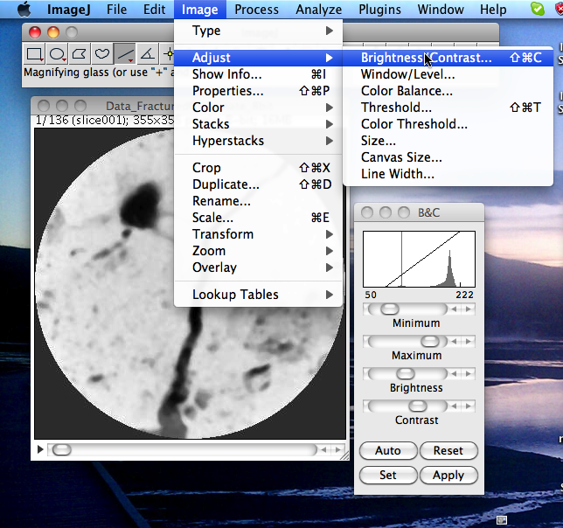
Image->Adjust->Brightness/Contrast
This image shows OK.
Sometimes automatic settings are not best for showing the data at hand
Using options shown you can adjust min/max data displayed without changing the actual data

Slide 4
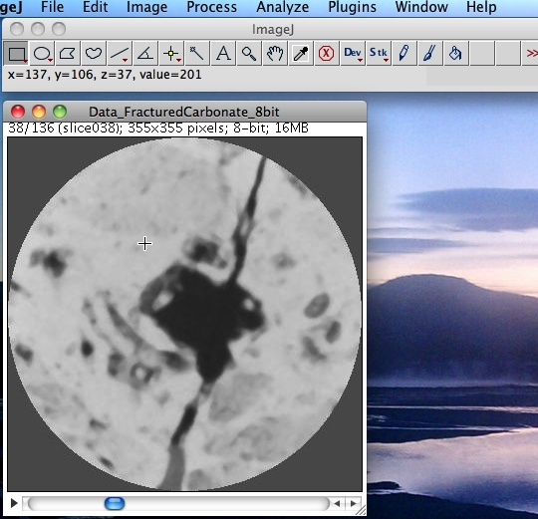
Basic image information
If you click on the image, and move mouse around, the information on x,y position and image value at (x,y) will show in the main ImageJ window.
You should always know basic information about your image (8bit or 16bit, grayscale or RGB, number of slices, etc…)
View and change type from Image->Type
Image-> Show Info
ImageJ allows you to walk through slices
File > Save As >Animated Gif allows you to save a movie of all slices
Notes:
LUT = Look up table
e.g. in Show Info, it will say “Grayscale LUT”

