Slide 1
MetaEngine
MD
PACS
IPVL5
Eagle
/rsrch1

Slide 2
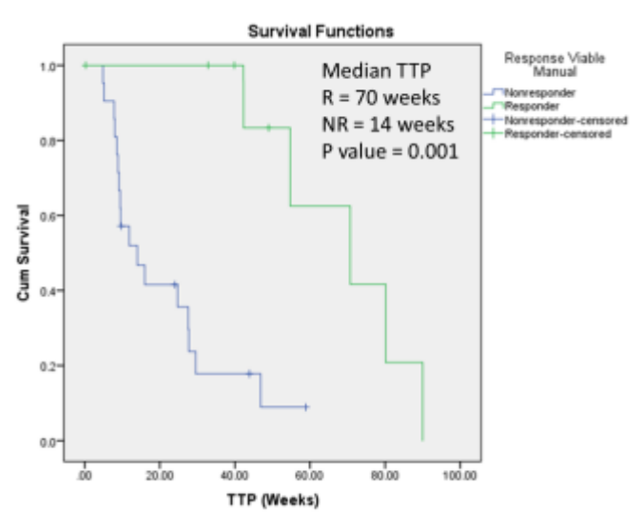
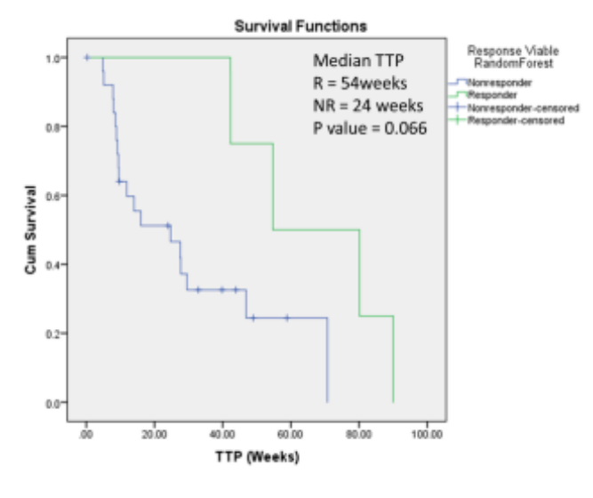
Manual -vs- Automatic

Slide 3
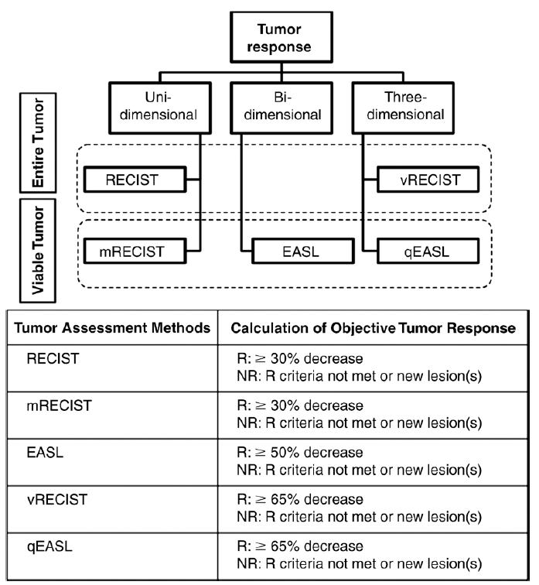
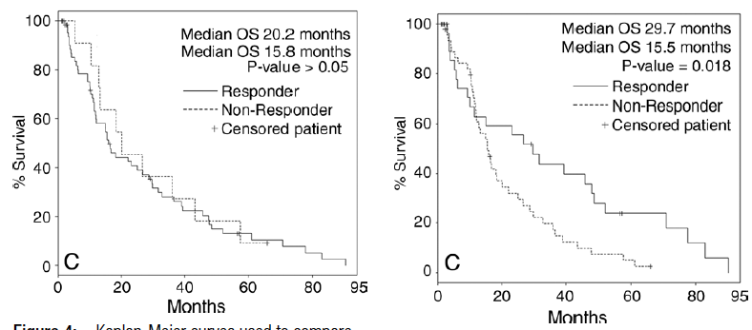
2D – no difference in response
detection
3D – statistically different response detection

Slide 4
survival 0/1
survival 0/1
Treatment 1
Treatment 2
…
t6
t7
t8
tf
t0
t1
t2
t3
t5
Baseline
Followup
Baseline
Followup

